Slide 1
Data & Privacy (Part-1)
Understanding the Risks and Protecting Your Personal Information

Slide 2
Learning Outcome
1. Privacy Risks: Recognize that collecting personal data can lead to unauthorized access, data breaches, and identity theft.
2. Examples of PII: Identify PII such as names, addresses, phone numbers, and social security numbers.
3. Data Privacy Basics: Understand the importance of consent, data minimization, and individual rights regarding personal information.
4. Personal Data Classification: Differentiate between sensitive and non-sensitive personal data to implement effective protection measures.

Slide 3
What is Data Privacy ?
Definition: Data privacy refers to how personal information is collected, used, and shared. It involves making sure that your personal data is protected and that you control who can access it.
Explanation: Every time you sign up for an app, use a website, or even search for something online, companies collect information about you. Data privacy ensures that this information is kept safe and is not shared without your permission.
Example: If you create an account on a social media platform, you’re giving the platform your personal information like your name, age, and possibly your location. Data privacy makes sure this information doesn’t get into the wrong hands.

Slide 4
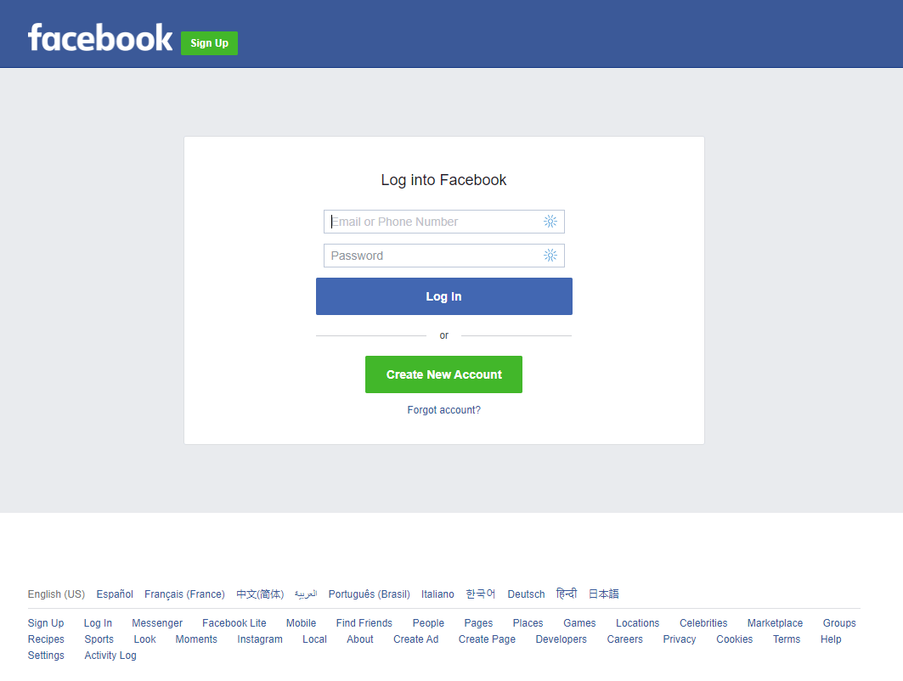
What is Personal Data ?
Definition: Personal data is any information that can be used to identify a specific person.
Types of Personal Data:
Direct Personal Data: Information that clearly identifies who you are, such as:
Your full name
Your home address
Your phone number
Your email address
Indirect Personal Data: Information that can be combined with other data to identify you, such as:
Your IP address (the address of your internet connection)
Your search history
Information about your hobbies or interests
Examples: When you sign up for a service online and provide your name and email address, this is personal data. Similarly, when you order something online, your delivery address is also personal data.

Slide 5
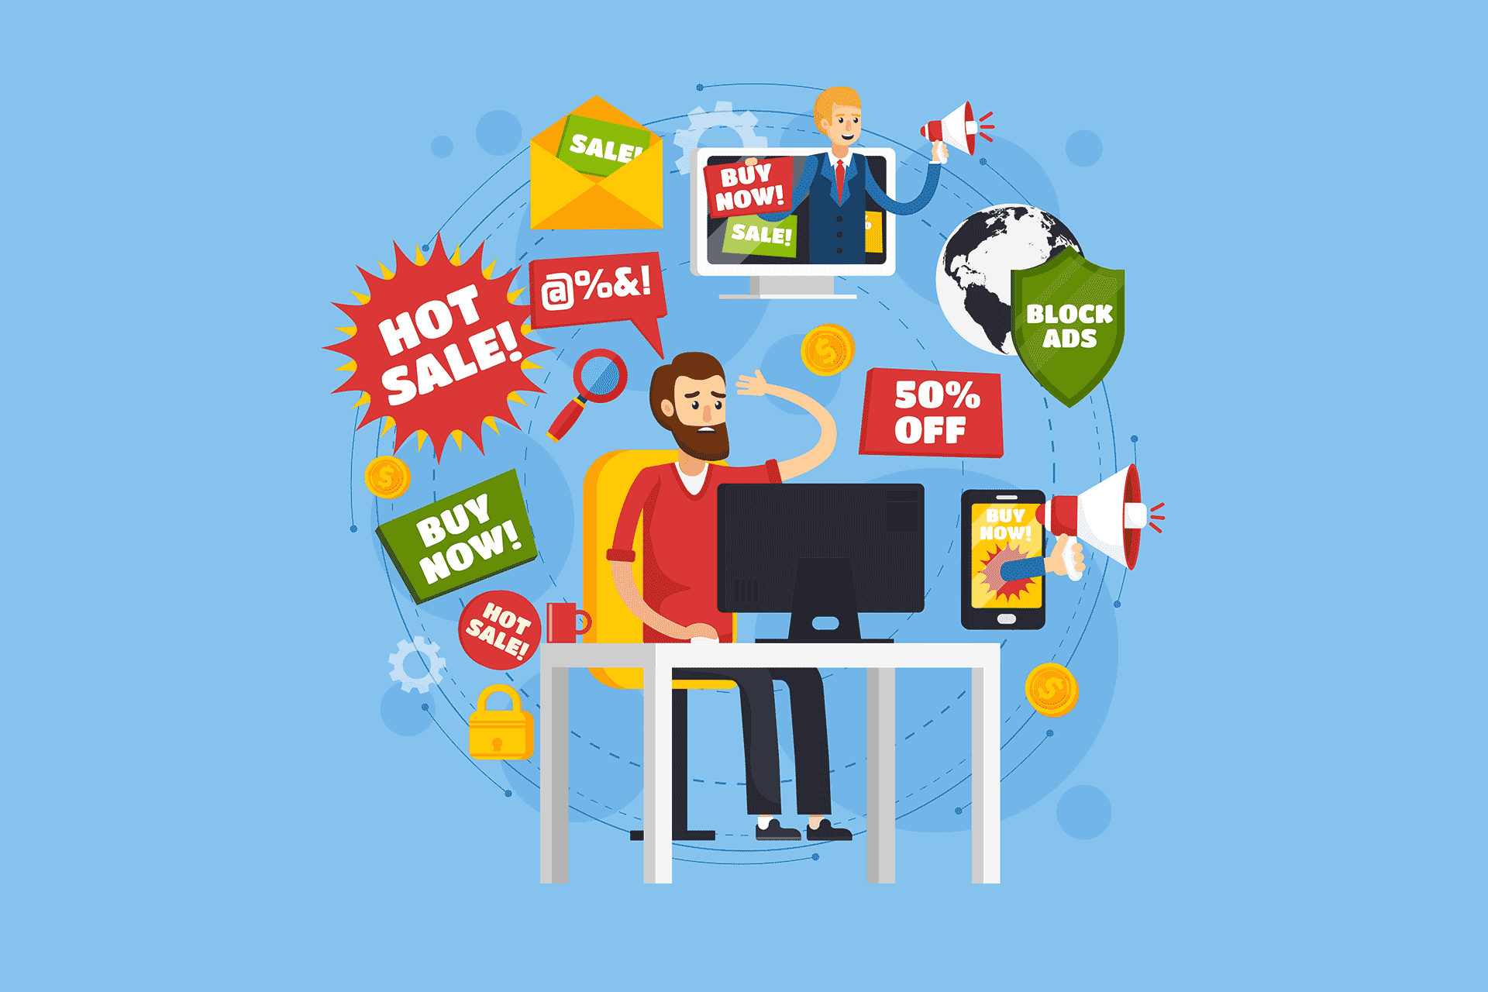
Why is Personal Data Important ?
Definition: Personal data is important because it can be used to identify, contact, or locate you. Companies use this data for various purposes, such as:
Improving services by understanding user preferences.
Personalizing experiences (e.g., customized ads or recommendations).
Running analytics to see how many people use their products.
Why it Matters: If personal data isn’t protected, it can be misused. For instance, companies may use it to send you ads you don’t want, or worse, if someone malicious gains access to it, they might try to impersonate you.
Example: A gaming website might use your data (like your name and email) to recommend games you might enjoy based on what you’ve played before. But if that data is leaked or sold, it could end up in the hands of advertisers who will send you irrelevant ads.

Slide 6
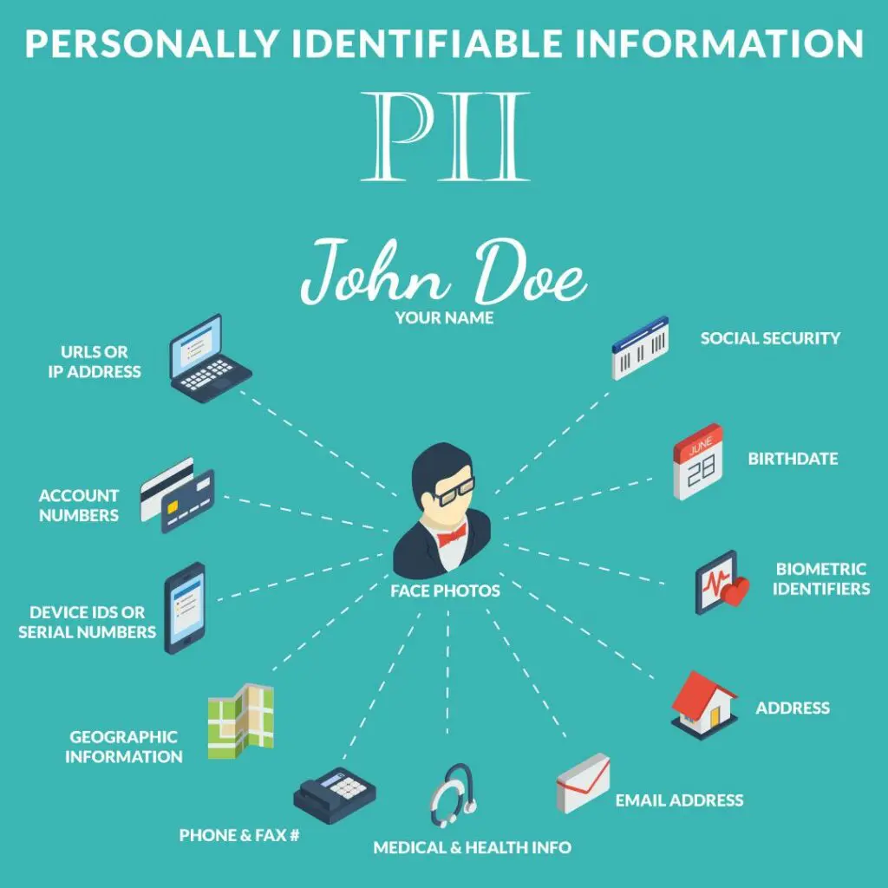
What is PII (Personally Identifiable Information)?
Definition: PII is any data that can be used to identify a specific person directly. It’s considered more sensitive than general personal data because it can be used to uniquely identify someone.
Examples of PII:
Full name (John Smith)
Home address (123 Main St, New York)
Phone number (555-1234)
Social Security Number (for adults)
Passport or ID number
Explanation: PII is often protected by law because if this information is exposed, it can lead to serious issues like identity theft.
Example: When you sign up for school exams or online courses, you give your name and maybe your student ID number. These details are considered PII because they identify you specifically.

Slide 7
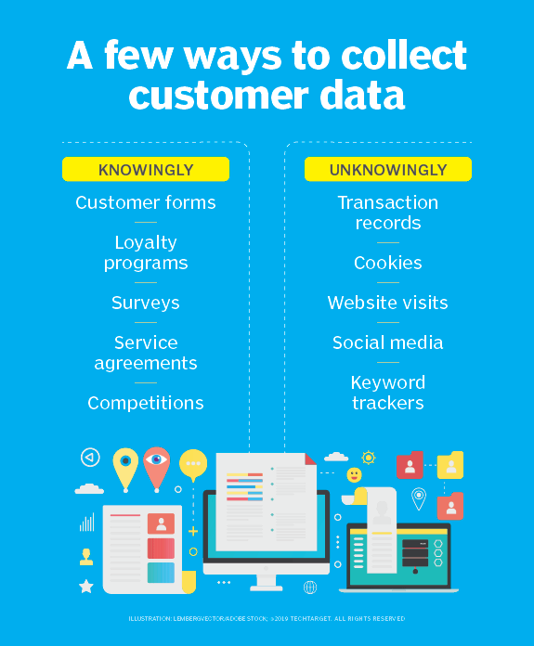
How is Personal Data Collected ?
Methods of Collection:
Directly: When you fill out a form, sign up for an account, or make a purchase, you are directly providing your personal data.
Indirectly: Some data is collected automatically when you visit websites or use apps. This could be your browsing history, IP address, or location data.
Examples:
Direct Collection: Signing up for a new email account requires your name, birthdate, and phone number.
Indirect Collection: A website may use “cookies” (small files) to track what you’re looking at and send you related ads.
Why This Happens: Companies collect data to improve their services, help you find what you need faster, and sometimes to sell targeted advertisements.

Slide 8
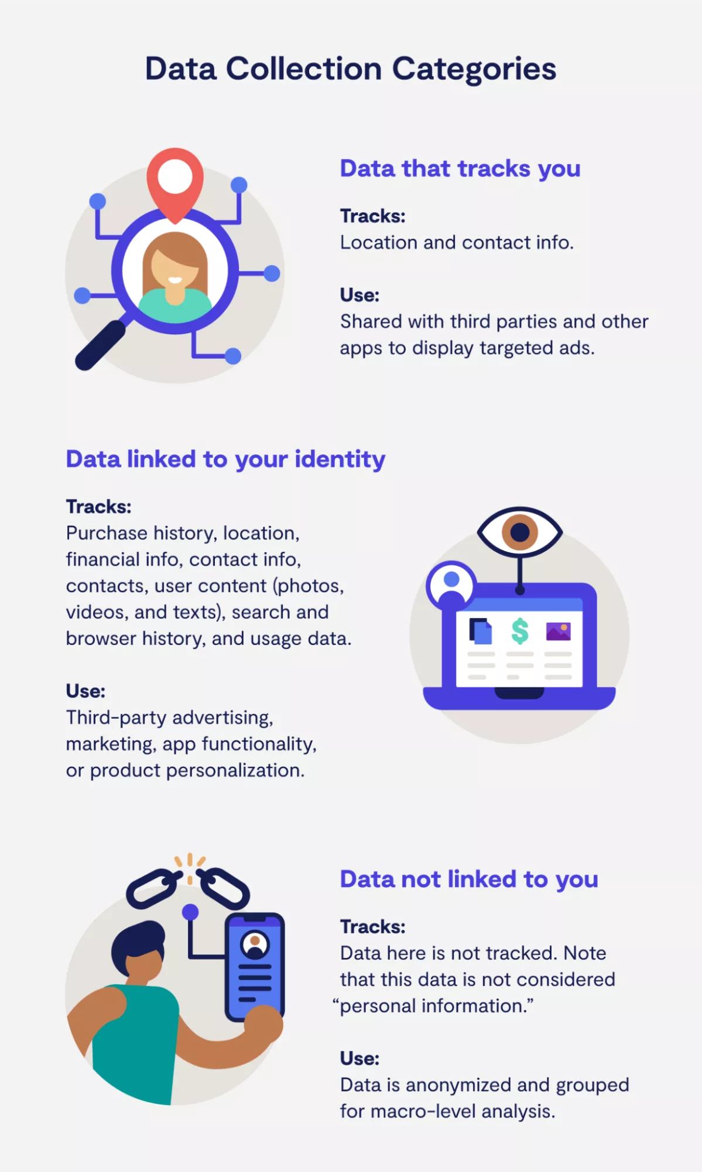
How Companies Use Your Personal Data
Personalized Experience: Companies use your data to give you a customized experience. For example, Netflix uses your watch history to recommend shows you might like.
Advertising: Companies can show you specific ads based on your interests and personal data. If you search for new shoes, you may start seeing ads for shoe sales.
Service Improvement: Data helps companies understand what users like or dislike about their services, so they can make improvements.
Example: When you use Google Maps, it collects location data to give you traffic updates and route recommendations.

Slide 9
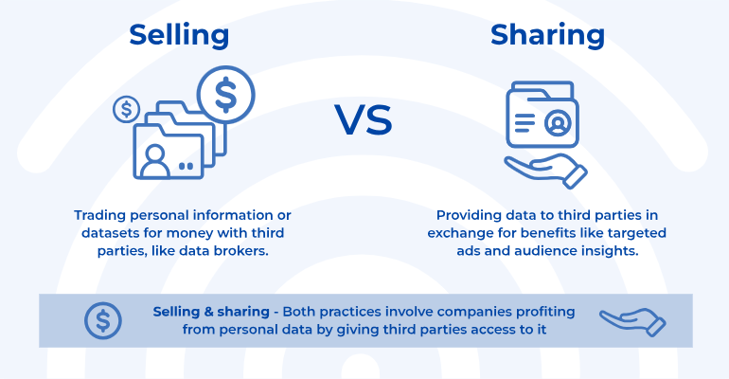
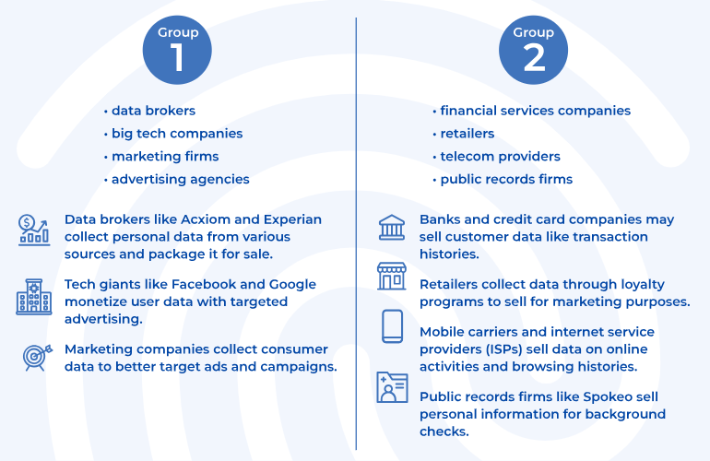
Risks to Privacy from Data Collection
Risk 1: Data Misuse: Companies might use your data in ways you don’t expect or agree with. For example, a company could sell your data to advertisers who will flood you with emails or ads.
Risk 2: Sharing Without Consent: Some companies might share your data with others without asking you first. This could include selling your email to marketers or sharing your browsing history with other businesses.
Risk 3: Unwanted Tracking: Some websites track your online behavior without you knowing, like where you click or how long you stay on a page.
Example: If you use a shopping website, it may track what products you look at and then show you ads for similar items even after you leave the site.

Slide 10
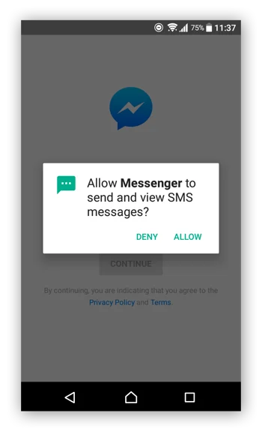
How Can You Protect Your Personal Data ?
Tip 1: Use Strong Passwords: Create passwords that are hard to guess by using a mix of letters, numbers, and special characters. Avoid using obvious information like your name or birthdate.
Tip 2: Be Careful What You Share: Only give out personal data on trusted websites or apps. If a site asks for unnecessary data, think twice before providing it.
Tip 3: Adjust Privacy Settings: On social media and apps, make sure your privacy settings are set to limit who can see your information.
Example: When signing up for a new app, you might want to check the permissions it asks for (like location or contacts) and turn off anything that seems unnecessary.

Slide 11

The Role of Privacy Laws
Definition: Privacy laws are rules that help protect your personal data. They ensure that companies ask for permission before collecting and using your data.
Example 1: GDPR (General Data Protection Regulation): A law in Europe that gives you control over your personal data. Companies need to ask your permission to use your data and must delete it if you request.
Example 2: CCPA (California Consumer Privacy Act): A law in the US that lets you know what personal data companies collect and gives you the right to stop them from selling it.
Why It Matters: Privacy laws are designed to make sure your data isn’t collected or used without your knowledge. They give you more control over who can access your information.

Slide 12
Multiple Choice Questions
1. What is a major risk of collecting personal data?
- A) Improved user experience
- B) Data breaches
- C) Increased storage costs
- D) Better marketing strategies
2. Which of the following is considered personally identifiable information (PII)?
- A) A person's favorite color
- B) A person's social security number
- C) A book title
- D) A website URL

Slide 13
3. What is the principle of data minimization?
- A) Collecting as much data as possible
- B) Only collecting data that is necessary for a specific purpose
- C) Storing data indefinitely
- D) Sharing data with third parties
4. Which of the following best defines sensitive personal data?
- A) General information like job titles
- B) Data that can identify someone, such as names
- C) Health records and financial information
- D) Publicly available information

Slide 14
5. What is a key right individuals have regarding their personal data?
- A) Right to unlimited data collection
- B) Right to access and request deletion of their data
- C) Right to sell their data
- D) Right to share their data without consent

Slide 15
Answers
1. B) Data breaches
2. B) A person's social security number
3. B) Only collecting data that is necessary for a specific purpose
4. C) Health records and financial information
5. B) Right to access and request deletion of their data

Slide 16


